Slide 1


Optimizing Emergency Fire Response Using Traffic Data
Furkan Karagöz 040210008
Alim Ege Uzun 040230755

Slide 2
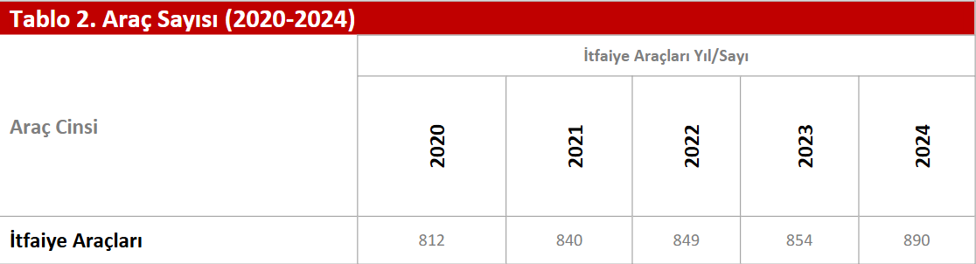
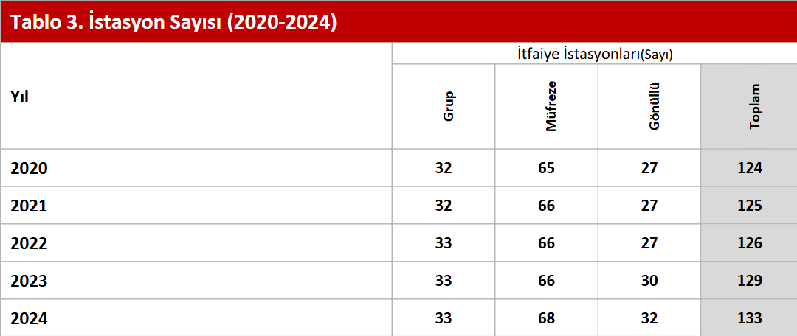
Istanbul Fire Stations and Vehicle Counts

Slide 3
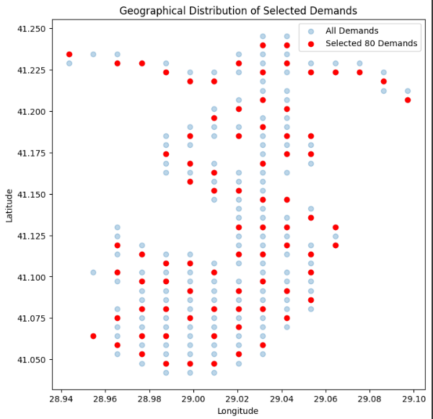
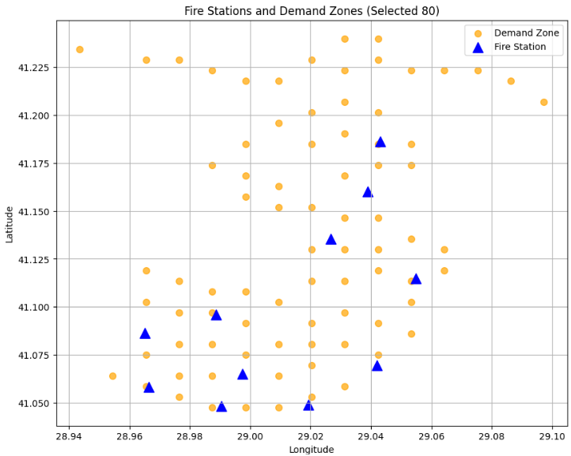
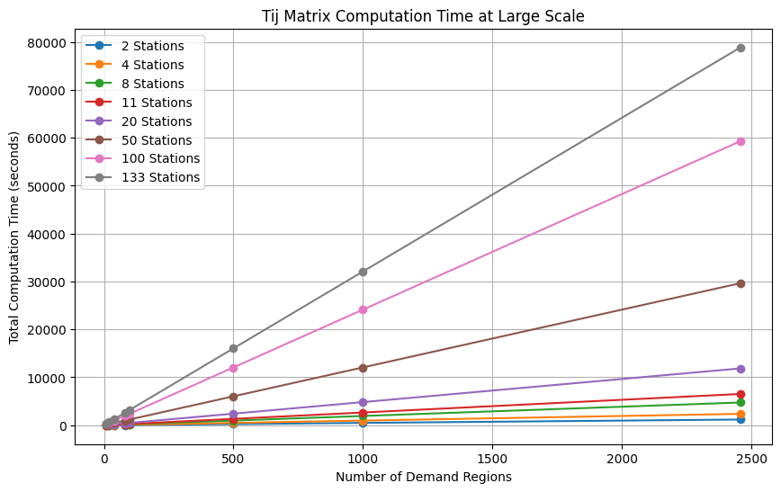
In order to work more easily with the geohash regions in Kağıthane, Beşiktaş, Şişli, and Sarıyer, and to account for the capacity limits of the stations, we reduced the number of regions to 80 using the clustering method.

Slide 4
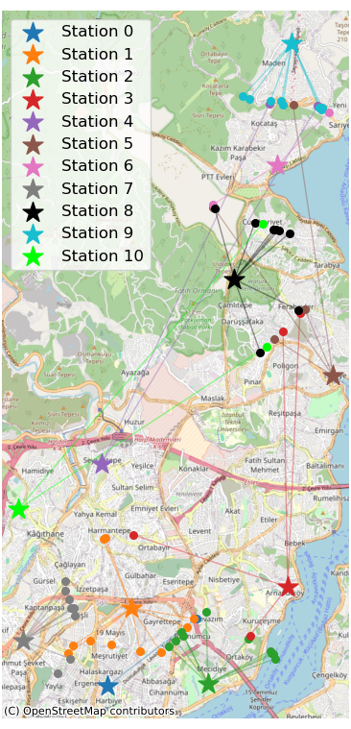
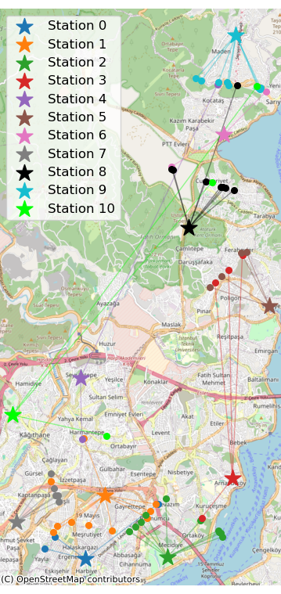
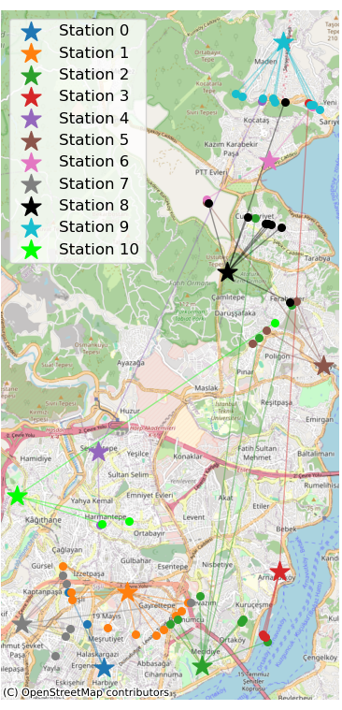
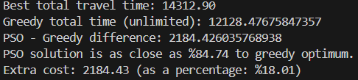
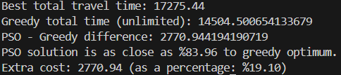
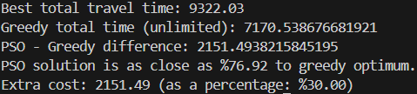
Station-zone assignments using the PSO algorithm (static assignment and assignment for 2 and 10 o'clock)

Slide 5
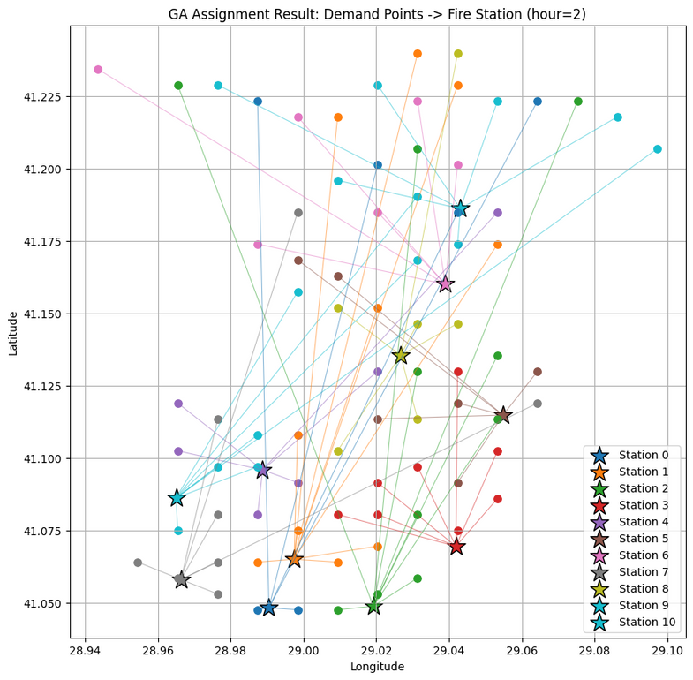
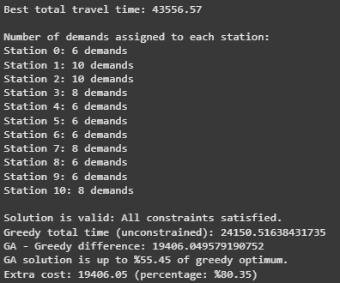
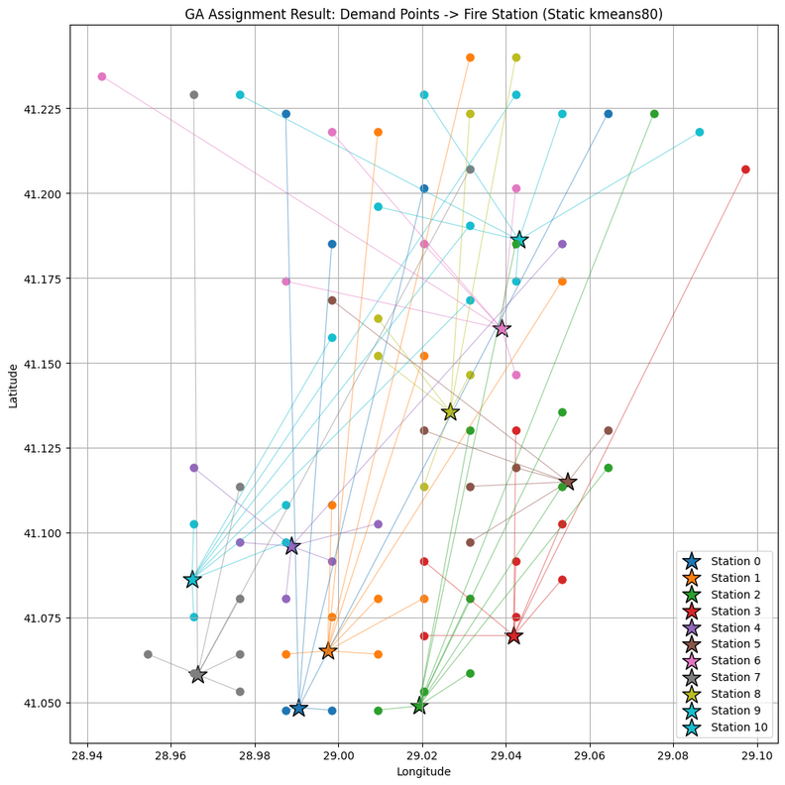
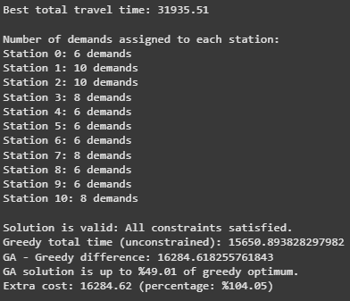
GA K-Means vs. GA Static
Assignment by GA using a static, distance-only matrix.
Ignores real traffic and road network effects.
Hour 2: Assignment optimized by GA using OSMnx-based travel times and KMeans demand zones.
More balanced and realistic allocation.

Slide 6
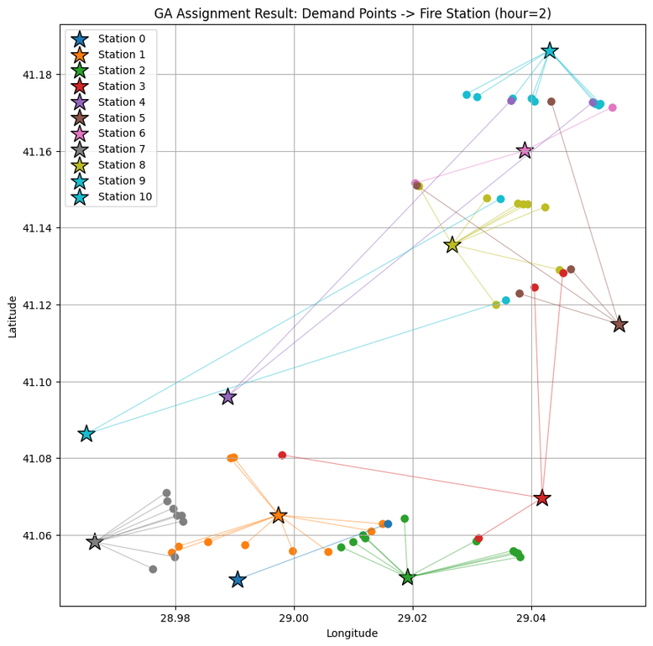
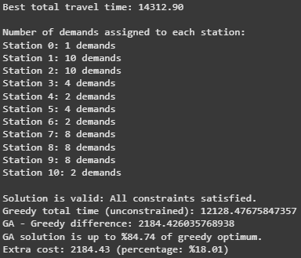
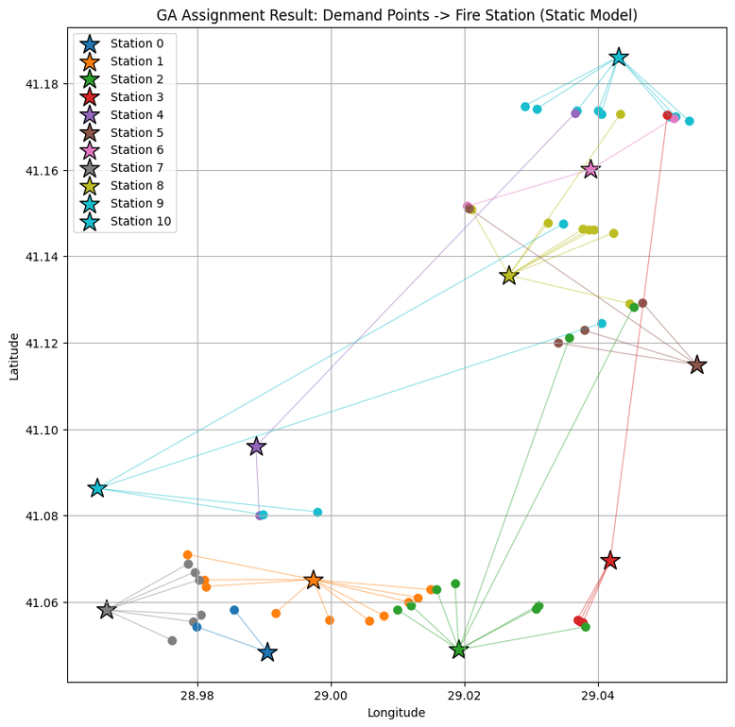
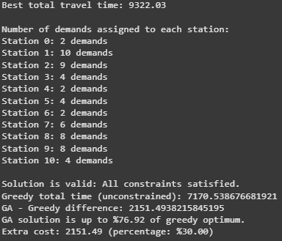
GA Critic Points vs. GA Static
GA assignment using a static, distance-only matrix for critical demand points.
Does not account for real traffic or actual road network conditions.
GA assignment using OSMnx-based travel times and real traffic speeds at critical demand points.
Provides a more realistic and balanced station allocation.

Slide 7
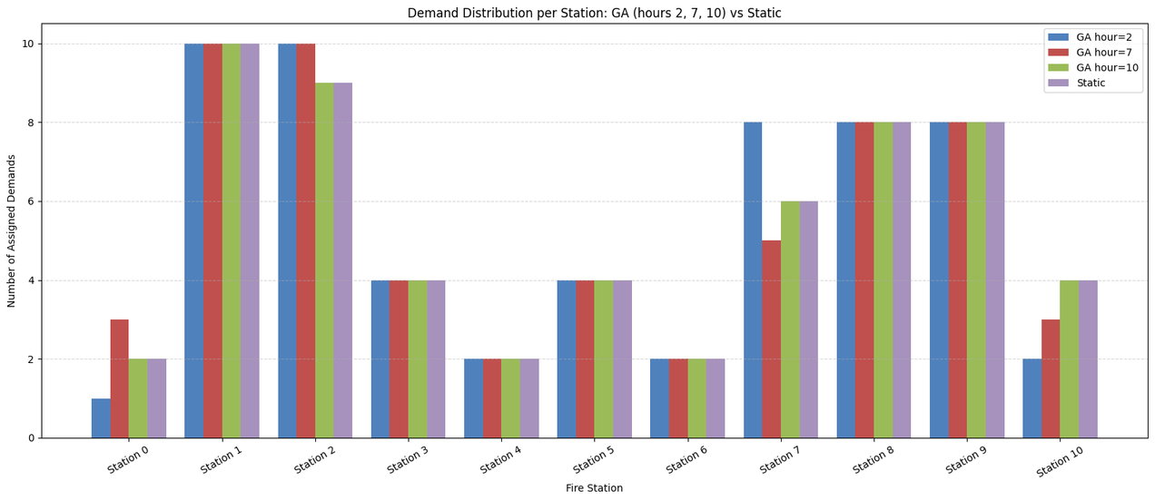
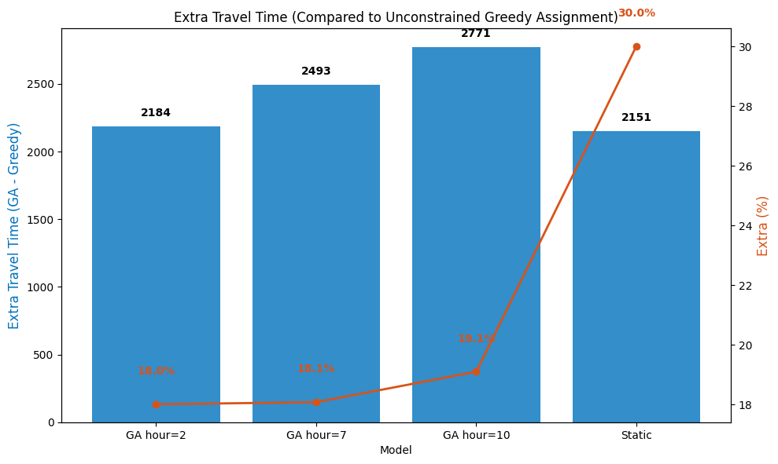
Demand Distribution Across Stations
GA with real data balances demand more effectively; Static GA is less flexible.
Dynamic, traffic-aware assignment improves coverage and station utilization.
Static vs Real-Data GA: Less Efficient
GA with real traffic data keeps extra travel time low and stable (~18-19%), while Static GA results in much higher extra travel time (30%).
Static assignment causes more inefficiency.
Dynamic, real-data-based GA reduces unnecessary travel.

